Slide 1
Audio-to-Text Model

Slide 2
Outline
Introduction
Literature Review
  CNN
  Random Forest
Method
Result
Reference

Slide 3
Introduction
The concept of audio-to-text models:
  Google uses a mix of deep learning and Natural Language Processing (NLP) techniques to parse through our query, retrieve the answer and present it in the form of both audio and text.
build audio-to-text model using my Python and deep learning skills myself.
It’s a fascinating concept which I could integrate what I have learned in DSP.

Slide 4
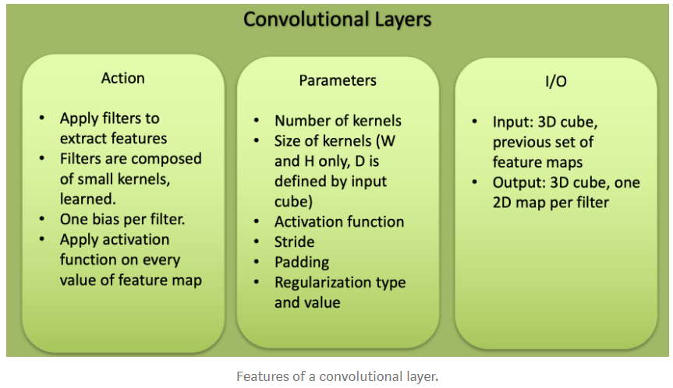
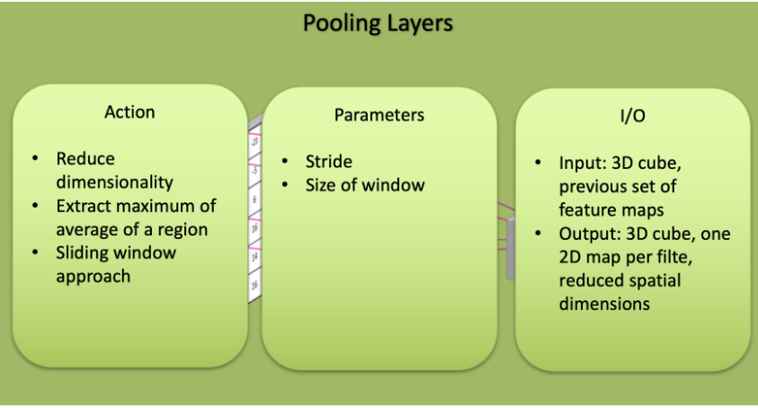
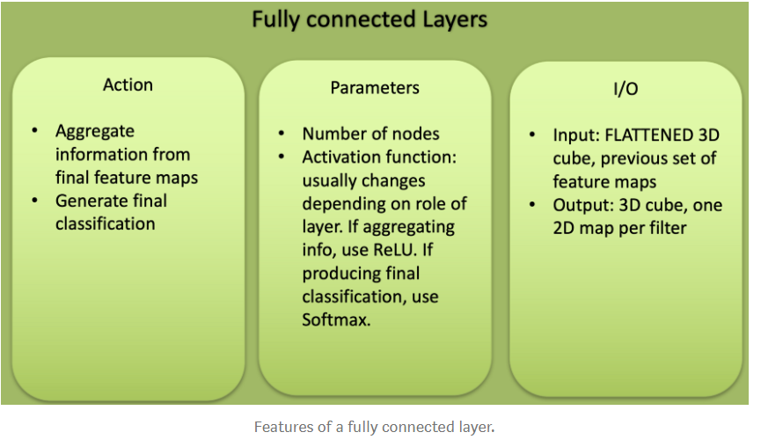
Literature Review: CNN
three types of layers in a CNN: convolutional layer, pooling layer, fully connected layer.

Slide 5
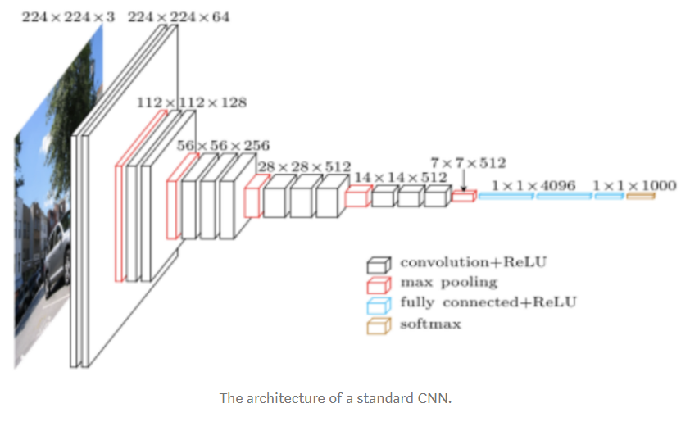
Literature Review: CNN
What do CNN layers learn?
Each CNN layer learns filters of increasing complexity.
The first layers learn basic feature detection filters: edges, corners
The middle layers learn filters that detect parts of objects.
The last layers have higher representations: they learn to recognize full objects, in different shapes and positions.

Slide 6
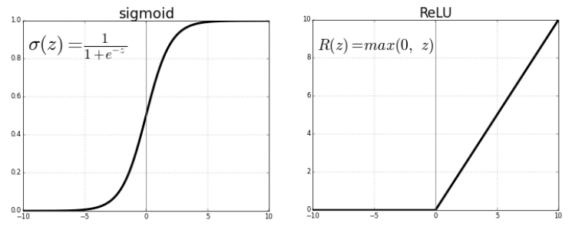
Literature Review: CNN
Activation function
  Pick an activation function for each layer. It takes that ((w • x) + b) and calculates a probability. Then it sets a threshold to determine whether the neuron ((w • x) + b) should be 1 (true) or (0) negative.
Relu activation function/Sigmoid activation function
Sigmoid uses the logistic function, 1 / (1 + e**z) where z = f(x) = ((w • x) + b).
Relu is 1 for all positive values and 0 for all negative ones
The most successful non-linearity for CNN’s is the Rectified Non-Linear unit (ReLU), which combats the vanishing gradient problem occurring in sigmoids. ReLU is easier to compute and generates sparsity.

Slide 7
Literature Review: Random Forest
Random Forest
The RF is the ensemble of decision trees. Each decision tree, in the ensemble, process the sample and predicts the output label. Decision trees in the ensemble are independent. Each can predict the final response.

Slide 8
Method
1. Importing libraries in Python
2. Visualizing the audio data, Sampling the data and resampling.
3. Preprocess the data
4. Split into train and test set
5. Implementing the machine learning models
  CNN
  Random Forest
6. Predict and see the accuracy of test set

Slide 9
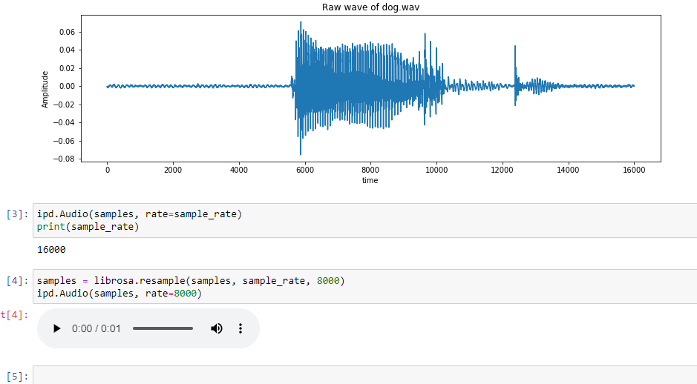
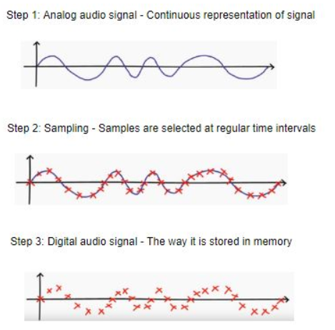
Visualizing the audio data,
Sampling the data and resampling.
The sampling rate is 16,000 Hz. Resample it to 8000 Hz, since most of the speech frequencies are present at 8000 Hz.
Why sampling the audio signal?
  Since audio signal is continuous, we need to convert the analog signal analog signals to digital signals so that we can work with them easily. This is called sampling the signal, in order to make it become discrete. The sampling rate or sampling frequency is the number of samples selected per second.

Slide 10
Preprocess the data
convert it to integer by importing LabelEncoder library.
It is a muti-classification problem, convert the interger encoded labels to one-hot vector by importing np_utils library.
Reshaping the data from 2D to 3D in order to train the CNN model later.
Split into train and test set
  Train the model on 70% of the data and validate on the remaining30% by importing train_test_split library.

Slide 11
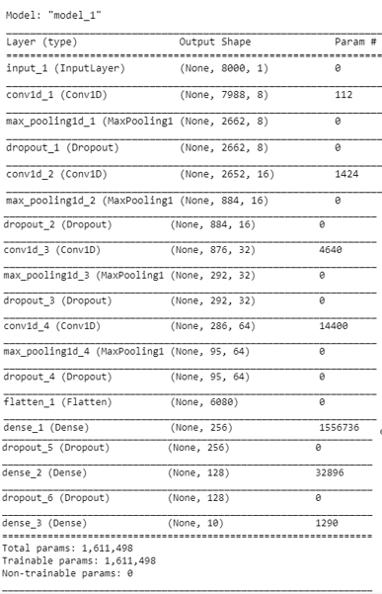
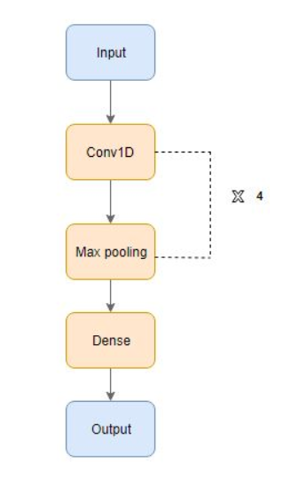
Implementing the machine learning models
Conv1D:
A 1-Dimensional convolution layer applies a convolution on two 1-dimensional data types (vectors, signals)
Max Pooling:
Maximum Pooling is the process of splitting the data into several regions, taking the maximum value of a cell in those regions, and inserting them into an output matrix.
Dropout Layer:
The Dropout layer, used to prevent overfitting in neural networks, randomly sets a fraction ‘rate’ of input units to 0 at each update during training time.
Flatten Layer:
The Flatten layer converts multi-dimensional data into a single vector to be processed.
Dense Layer:
The Dense layer is a standard neural network layer.

Slide 12
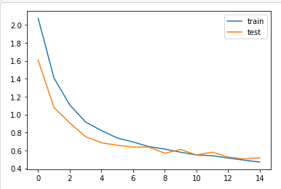
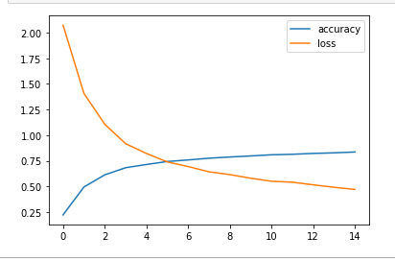
Result: CNN with Relu activation function
  After training for 15 epochs and with batch size32, we evaluate the model.
  After 15 epochs with Relu activation function, the accuracy comes to 0.8286 and the loss is 0.4703 which performs very well.
  The following is the loss of the training set and testing set and the accuracy and loss of the data.

Slide 13
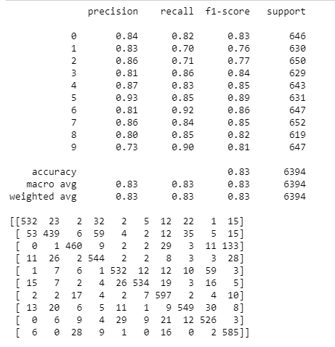
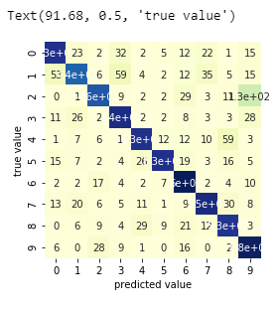
Result: CNN with Relu activation function
confusion matrix and heatmap:
Confusion matrix C is such that c(i,j) is equal to the number of observations known to be in group i but predicted to be in group j.

Slide 14
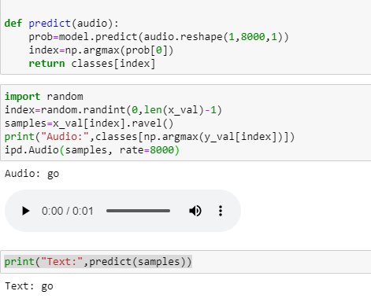
Result: CNN with Relu activation function
The last part of the code is to predict and print one of the data and the predict is good.

Slide 15
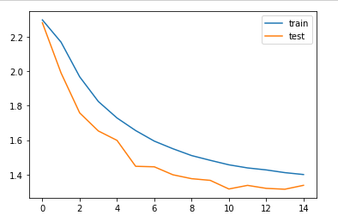
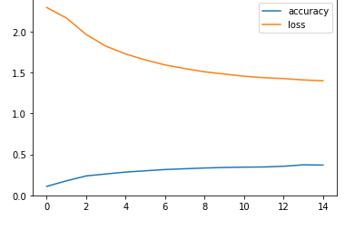
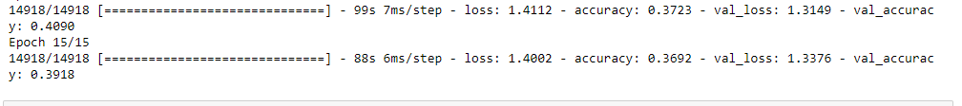
Result: CNN with Sigmoid activation function
The accuracy:0.3918
Loss of the training set and testing set

Slide 16
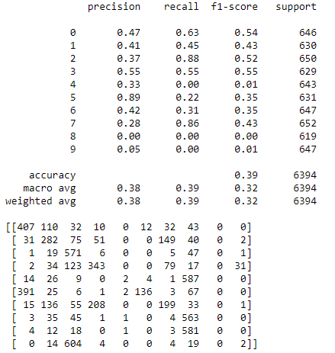
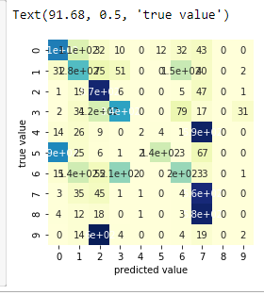
Result: CNN with Sigmoid activation function
confusion matrix and heatmap:
Confusion matrix C is such that c(i,j) is equal to the number of observations known to be in group i but predicted to be in group j.

Slide 17
Result: Random Forest Tree with Entropy, Max depth(20/60)
Random Forest:
  Since Random Forest classifier is not suitable for the audio signal to text model, the accuracy turns out to be bad.
  Decision could only work with data with table format, which CNN can be implemented in Images, audio and text.

Slide 18
Reference
https://www.analyticsvidhya.com/blog/2019/07/learn-build-first-speech-to-text-model-python/
https://www.kaggle.com/c/tensorflow-speech-recognition-challenge/data?select=train.7z
https://github.com/aravindpai/Speech-Recognition/blob/master/Speech%20Recognition.ipynb
https://github.com/seth814/Audio-Classification
https://github.com/drscotthawley/panotti
https://en.wikipedia.org/wiki/Convolutional_neural_network
https://towardsdatascience.com/simple-introduction-to-convolutional-neural-networks-cdf8d3077bac
Spatial Pyramid Pooling in Deep Convolutional
Networks for Visual Recognition
https://medium.com/analytics-vidhya/a-guide-to-neural-network-layers-with-applications-in-keras-40ccb7ebb57a

